Slide 1
Firefox OS调研
吴西飞
2014年3月12日

Slide 2
Firefox OS简介
Firefox OS（ Boot to Gecko ，B2G）是新一代开源移动（智能手机和平板电脑）操作系统，2011年6月正式启动，由Mozilla主导开发 。
2012年7月2日，宣布它的正式名称为Firefox OS。
2013年2月24日，LG集团、中兴通讯、华为和TCL集团承诺将生产Firefox OS设备。
2013年12月12日，Mozilla宣布成立开放网络设备相容认证协会(Open Web Device Compliance Review Board)，成员包括德国电信、KDDI、LG、高通、索尼、展讯通信、TCL集团、西班牙电信、挪威电信和中兴通讯，该协会旨在于规范设备的性能和开发。
资料来源： http://zh.wikipedia.org/wiki/Firefox_OS#cite_note-theRegister-10

Slide 3
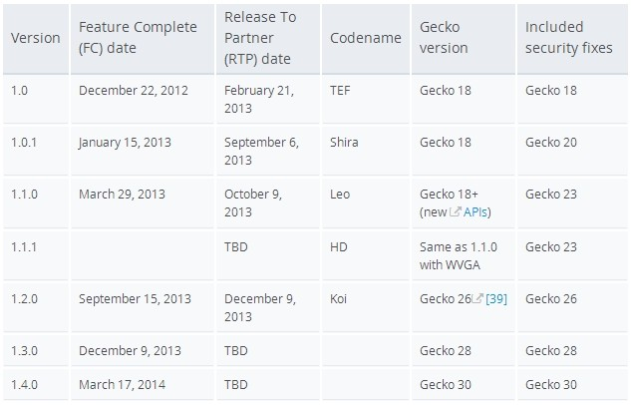
Firefox OS by version
参考网站: https://developer.mozilla.org/en-US/Firefox_OS

Slide 4
Firefox OS Devices
Name | Codename | Versions | Resolution | Display (inches) | CPU | Camera(s), Mpx | RAM | ROM | Battery (mAh)
Alcatel One Touch Fire | hamachi, buri | v1.0.1/v1.1 | 320 x 480 | 3.5 | Qualcomm MSM7227A 1 GHz | Rear: 3.2 | 256MB | 512MB | 1400
ZTE Open / variants | ikura | v1.0.1 (as shipped) | 320 x 480 | 3.5 | Qualcomm MSM7225A 800 MHz | Rear: 3.2 | 256MB | 512MB | 1200
LG Fireweb | leo | v1.1 | 320 x 480 | 4 | Qualcomm 1 GHz | Rear: 5 | 512MB | 4GB | 1540
Geeksphone Keon | keon | v1.0.1 - nightly | 320 x 480 | 3.5 | Qualcomm Snapdragon S1 7225AB 1 GHz | Rear: 3 | 512MB | 4GB | 1580
Geeksphone Peak | peak | v1.0.1 - nightly | 540 x 960 | 4.3 | Qualcomm Snapdragon S4 8225 1.2 GHz dual-core | Front: 2 Rear: 8 | 512MB | 4GB | 1800
Nexus 4 | nexus-4 | v1.3 - nightly | 768 x 1280 | 4.7 | Qualcomm Snapdragon S4 Pro 1.5 GHz quad-core | Rear: 8 | 2GB | 8 or 16GB | 2100
some phone thing | fugu | v1.2f (branch) per | 320 x 480 |  |  |  | 256MB
some 128MB platform thing | tarako | v1.3 per | 320 x 480 |  |  |  | 128MB (zram)

Slide 5
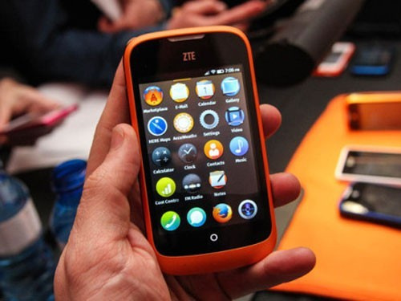
ZTE Open
2013年10月份，中兴基于Firefox OS系统的中兴Open智能手机将在今天正式发售，售价为69欧元，折合人民币552元。
中兴Open采用了3.5英寸480×320分辨率屏幕，内置256MB运行内存以及512MB存储空间，配备了320万像素摄像头，运行的 是Firefox OS操作系统。

Slide 6
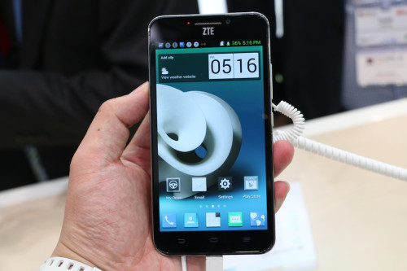
ZTE Grand Memo II
2014年02月24日，中兴发布ZTE Grand Memo II。硬件性能有了很大提升。
合作厂商：西班牙电信、中国联通、阿尔卡特、LG、ZTE中兴、华为。富士康计划推出针对Firefox OS的移动设备。

Slide 7
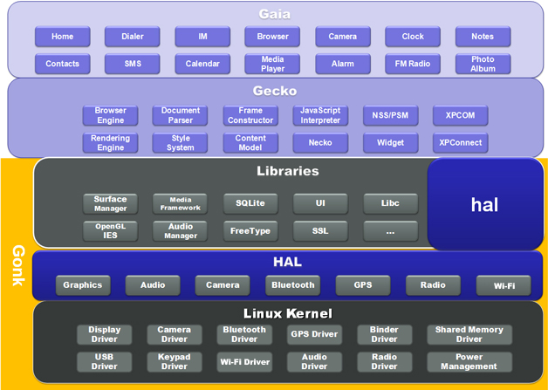
B2G Architecture

Slide 8
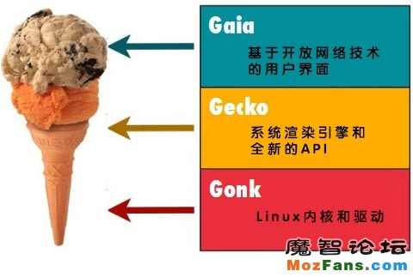
Gonk Gecko Gaia

Slide 9
Gonk层
Gonk is made up of a Linux kernel, based on the modified version supplied with the Android Open Source Project. On top of that, it's running a custom-built HAL (hardware abstraction layer) and several other low-level components. Most if not all of these are based on existing and tried open-source libraries and tools.
Gonk 基于Linux内核，是在Android开源项目的基础改进的。它的上层是一个定制的HAL（硬件抽象层）和其他几个底层组件。Gonk几乎所有模块都是基于现有的或已经成型的的开源库和工具。

Slide 10
B2G Architecture

Slide 11
Gecko层
Gecko is the "application runtime" of b2g. At a high level, Gecko implements the open standards for HTML, CSS, and JS and makes those interfaces run well on all the OSes that Gecko supports. This means that Gecko consists of, among other things, a networking stack, graphics stack, layout engine, virtual machine (for JS), and porting layers.
Gecko层是Firefox OS的技术核心，也是整个系统的应用运行环境，这一层提供对公开标准的支持。为了确保这一支持，这一层还包括其他内容，包括网络处理、图形图像处理、排版引擎、JavaScript虚拟机和对GonkHAL的支持等。

Slide 12
B2G Architecture

Slide 13
Gaia层
Gaia is the user interface of Firefox OS and controls everything drawn to screen. Gaia includes by default implementations of a lock screen, home screen, telephone dialer and contacts application, text-messaging application, camera application and a gallery support, plus the classic phone apps: mail, calendar, calculator and marketplace. Gaia is written entirely in HTML, CSS, and JavaScript. It interfaces with the operating system through Open Web APIs, which are implemented by Gecko. Because it uses only standard web APIs, it can work on other OSes and other web-browsers.
Gaia 层是指Firefox OS的用户界面层，屏幕上绘制通过该层来实现。此外还有如：锁屏、主界面、电话、联系人、短信、摄像头、画册、邮件、计算器、应用商场等。
Gaia只使用HTML, CSS, and JavaScript实现，和系统的交流通过开放网络标准，所以可以工作在其它支持该标准的系统和浏览器上。

Slide 14
总结
The Firefox OS for mobile devices is built on Mozilla’s “Boot to Gecko project” which unlocks many of the current limitations of web development on mobile, allowing HTML5 applications to access the underlying capabilities of a phone, previously only available to native applications.
Due to the optimization of the platform for entry-level smartphones and the removal of unnecessary middleware layers , mobile operators will have the ability to offer richer experiences at a range of price points including at the low end of the smartphone price range

Slide 15
谢谢~

